Slide 1
Patterns for Microservices

Slide 2
Spring Cloud Config
Spring Cloud Config is Spring’s client/server approach for storing and serving distributed configurations across multiple applications and environments.
This configuration store is ideally versioned under Git version control and can be modified at application runtime. While it fits very well in Spring applications using all the supported configuration file formats together with constructs like Environment, PropertySource or @Value, it can be used in any environment running any programming language.

Slide 3
NetFlix Eureka
The Eureka server is nothing but a service discovery pattern implementation, where every microservice is registered and a client microservice looks up the Eureka server to get a dependent microservice to get the job done.
The Eureka Server is a Netflix OSS product, and Spring Cloud offers a declarative way to register and invoke services by Java annotation.

Slide 4
Eureka Server/Client Communication
Every microservice registers itself in the Eureka server when bootstrapped, generally using the {ServiceId} it registers into the Eureka server, or it can use the hostname or any public IP (if those are fixed). After registering, every 30 seconds, it pings the Eureka server to notify it that the service itself is available. If the Eureka server not getting any pings from a service for a quite long time, this service is unregistered from the Eureka server automatically and the Eureka server notifies the new state of the registry to all other services.

Slide 5
Feign Client
Netflix provides Feign as an abstraction over REST-based calls, by which microservices can communicate with each other, but developers don't have to bother about REST internal details.
@FeignClient(name="currencyexchange")
@RibbonClient(name="currencyexchange")
public interface CurrencyExchangeServiceProxy {
@GetMapping("/currency-exchange/from/{from}/to/{to}")
public CurrencyBean retrieveExchangeValue(@PathVariable("from") String from,@PathVariable("to") String to);
}

Slide 6
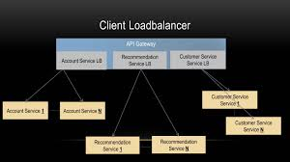
Netflix Ribbon
Netflix/ribbon: Ribbon is a Inter Process Communication (remote procedure calls) library with built in software load balancers. The primary usage model involves REST calls with various serialization scheme support.

Slide 7
Zuul API Gateway
Zuul acts as an API gateway or Edge service. It receives all the requests coming from the UI and then delegates the requests to internal microservices. So, we have to create a brand new microservice which is Zuul-enabled, and this service sits on top of all other microservices. It acts as an Edge service or client-facing service. Its Service API should be exposed to the client/UI. The client calls this service as a proxy for an internal microservice, then this service delegates the request to the appropriate service.
The advantage of this type of design is that common aspects like CORS, authentication, and security can be put into a centralized service, so all common aspects will be applied on each request, and if any changes occur in the future, we just have to update the business logic of this Edge Service.

Slide 8
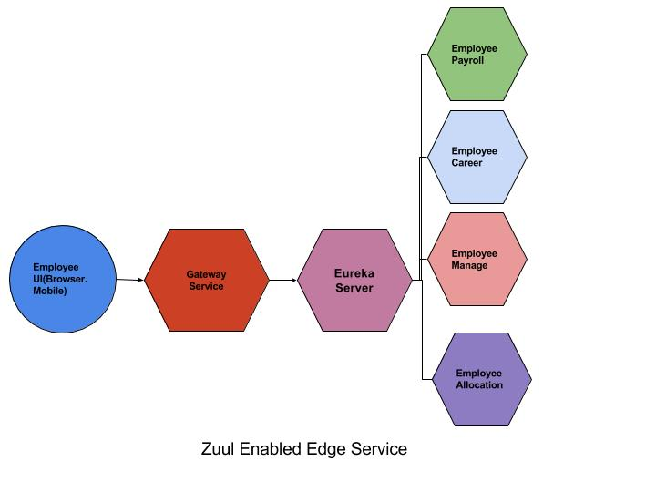

Slide 9
Hystrix
Netflix has created a library called Hystrix that implements the circuit breaker pattern. In a microservice architecture, it is common to have multiple layers of service calls,

Slide 10
Spring Cloud Zipkin and Sleuth
Zipkin is very efficient tool for distributed tracing in microservices ecosystem. Distributed tracing, in general, is latency measurement of each component in a distributed transaction where multiple microservices are invoked to serve a single business usecase. Let’s say from our application, we have to call 4 different services/components for a transaction. Here with distributed tracing enabled, we can measure which component took how much time.
This is useful during debugging when lots of underlying systems are involved and the application becomes slow in any particular situation. In such case, we first need to identify see which underlying service is actually slow. Once the slow service is identified, we can work to fix that issue. Distributed tracing helps in identifying that slow component among in the ecosystem.

